Slide 1

SOFTWARE
CONCEPTS
Student Name : L.H.G. Yasiru Prabodha Student Number : CL/OTHMFL3/11/56
A computer cannot do anything on its own. It must be instructed to do a job desired by us.
The term software refers to a set of computer program, procedures, and associated documents describing the program, and how they are to be used.
A software package is a group of program that solve a specific problem or perform a specific type of work.

Slide 2

SOFTWARE
INDRODUCTION
A computer cannot do anything on its own. It must be instructed to do a job desired by us.
The term software refers to a set of computer program, procedures, and associated documents describing the program, and how they are to be used.
A software package is a group of program that solve a specific problem or perform a specific type of work.
Student Name : L.H.G. Yasiru Prabodha Student Number : CL/OTHMFL3/11/56

Slide 3









SOFTWARE
TYPES
System Software
Application Software

Slide 4
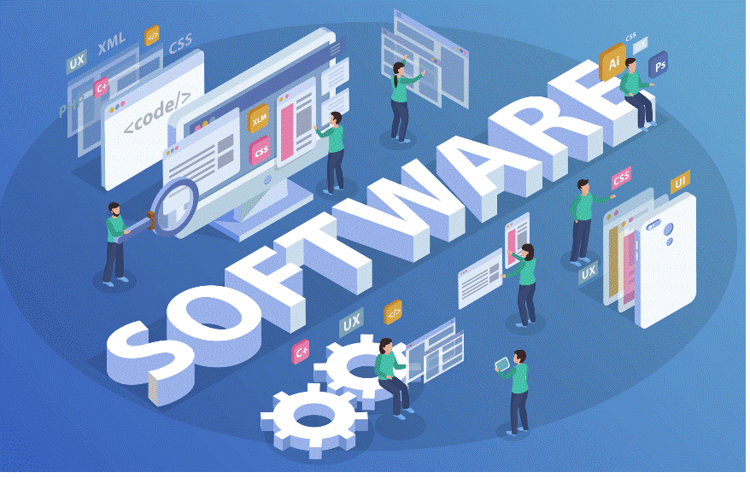
SYSTEM
SOFTWARE
System software refers to computer programs specifically created to manage and facilitate the operation of computer hardware. Its primary objectives are to deliver fundamental functionality and establish a foundation for the execution of application software. Components of system software encompass device drivers, operating systems, utility software, language processors, and more. The diverse roles of system software involve.

Slide 5

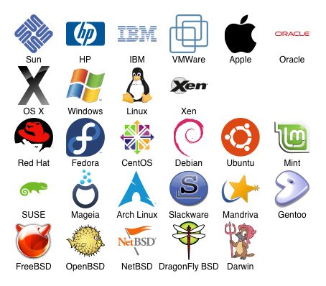
SYSTEM
TYPES
SOFTWARE
BIOS
Operating System
Device Drivers
Language Processors
Utility Software

Slide 6
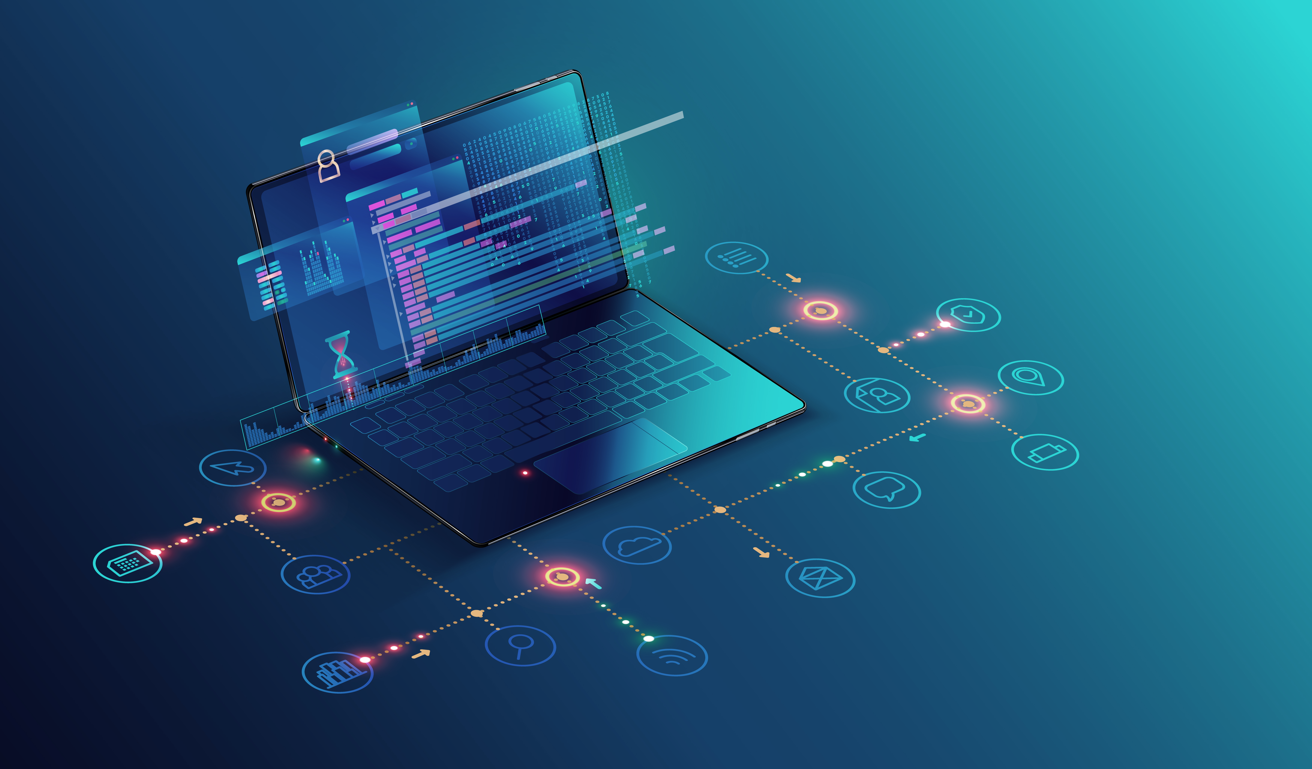
APPLICATION
SOFTWARE
Application software, often referred to as an application, comprises a collection of one or more programs crafted to enable users to carry out a coordinated set of functions, tasks, or activities. Unlike system software, application software cannot operate independently and relies on the support of system software for execution. Illustrative examples of applications encompass a word processor, a spreadsheet design and management system, an aeronautical flight simulator, a console game, a drawing, painting, and illustrating system, as well as a library management system.

Slide 7

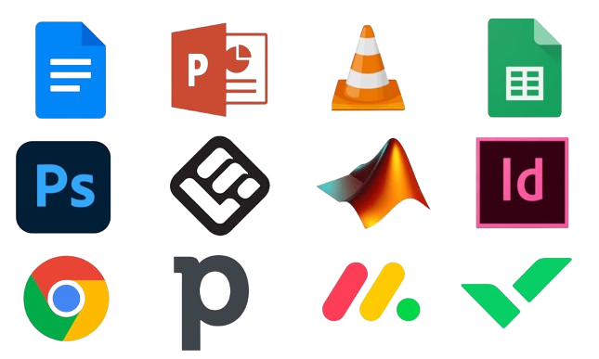
APPLICATION
TYPES
SOFTWARE
General purpose application software
Specific Purpose Application software
Developer Tools

Slide 8
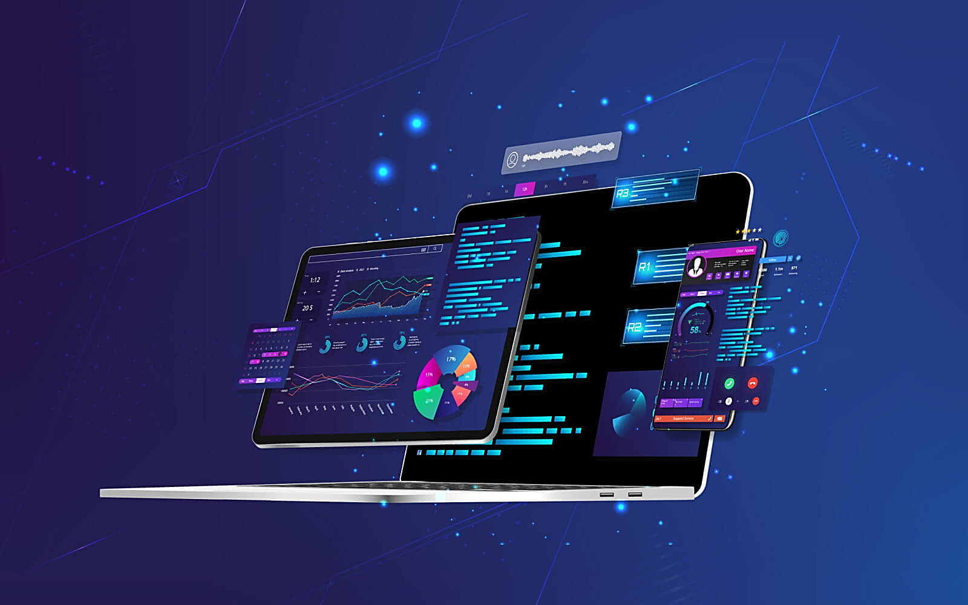
PROPRIETARY
SOFTWARE
Proprietary software is privately owned and its source code is restricted. Users are unable to modify or distribute it freely. Licensing typically involves restrictions, and proprietary software often requires payment for use.

Slide 9
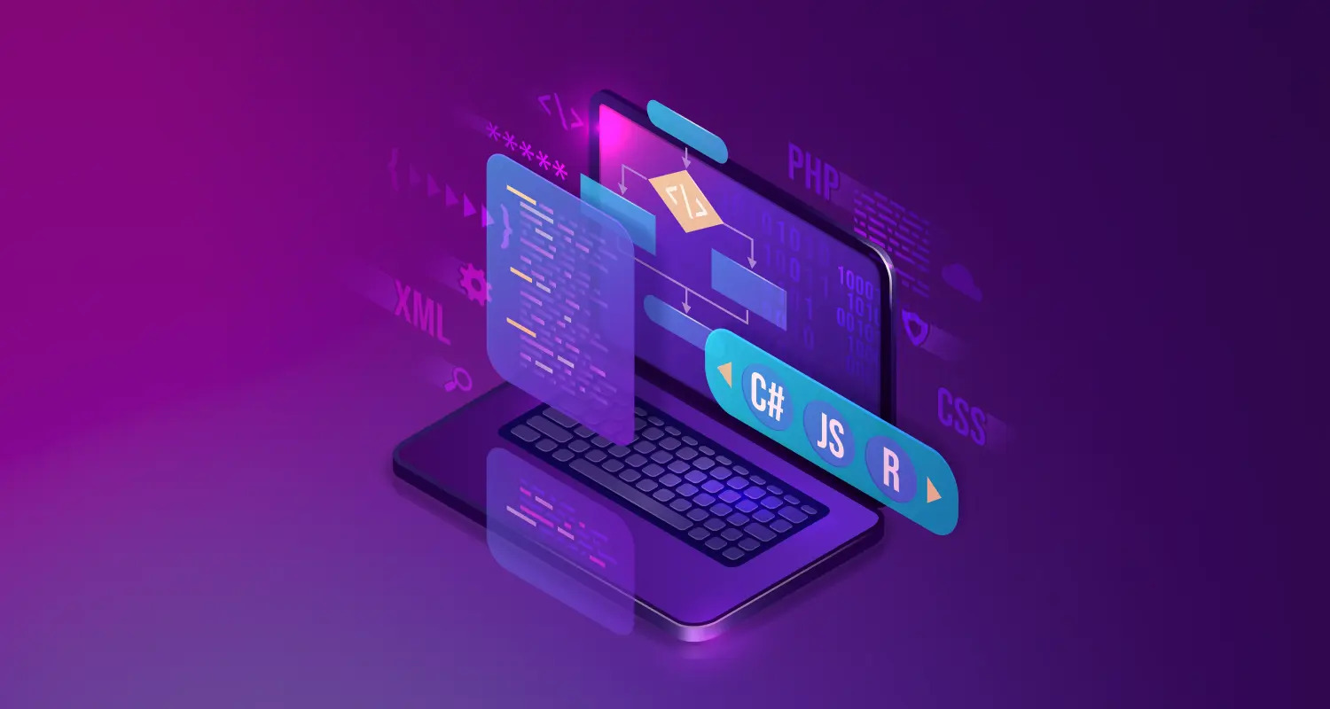
SHAREWARE
SOFTWARE
Shareware software is distributed on a trial basis, allowing users to evaluate it before purchasing. It often offers limited features in the trial version and requires payment for full functionality

Slide 10
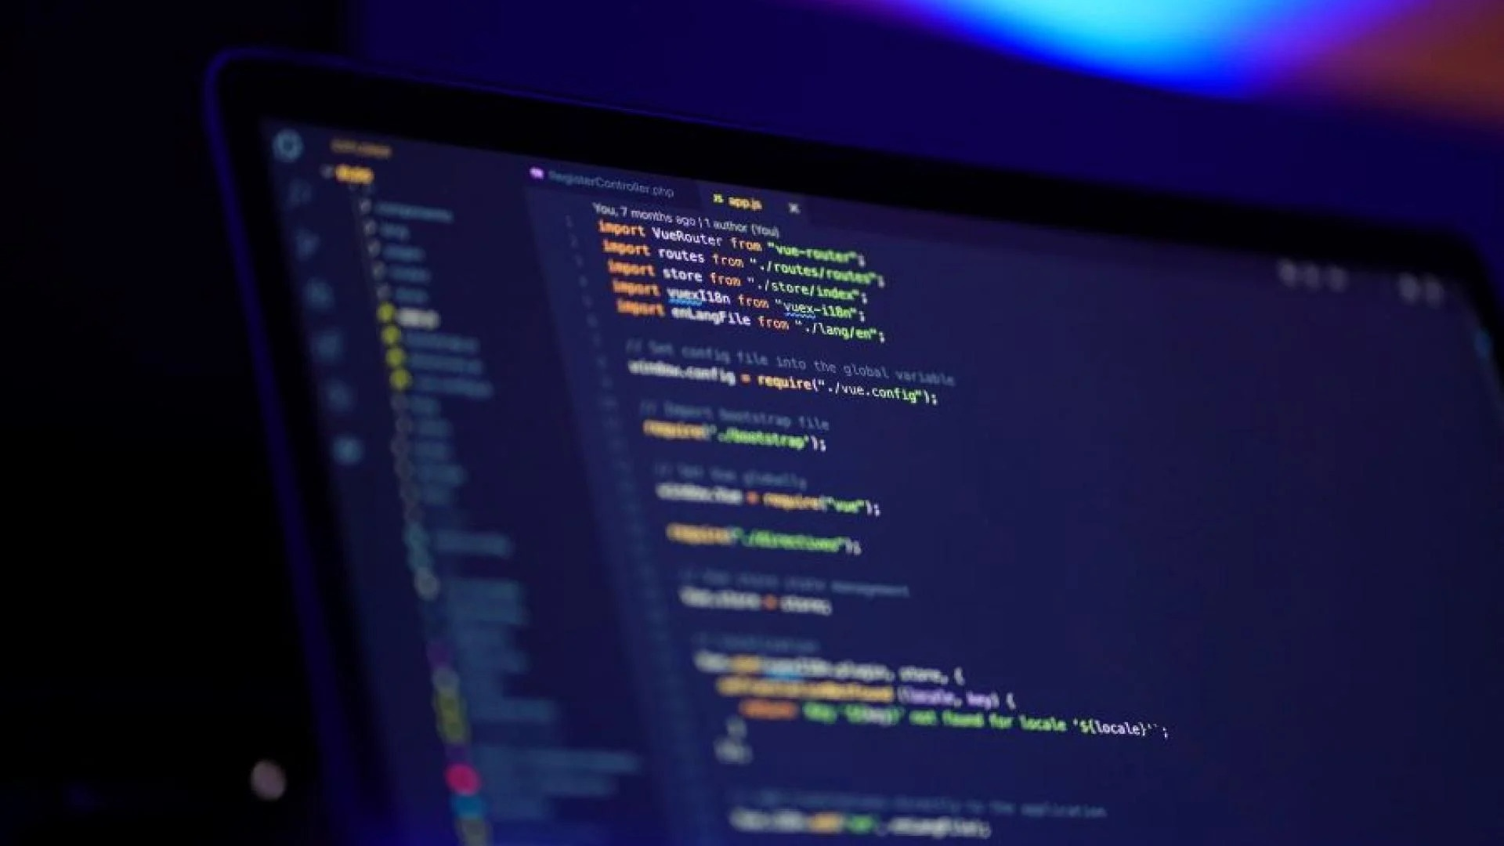
OPEN SOURCE
SOFTWARE
Open-source software is freely accessible, allowing users to view, modify, and distribute its source code. Collaboration and transparency characterize this approach, fostering community-driven development and innovation.

